Slide 1
Support Vector Machines Kernels

Slide 2
Learning Goals
In this section, we will cover:
- Using kernels with Support Vector Machines (SVM)
- Non-linear decision boundaries
- Implementation of SVM kernel modeling

Slide 3
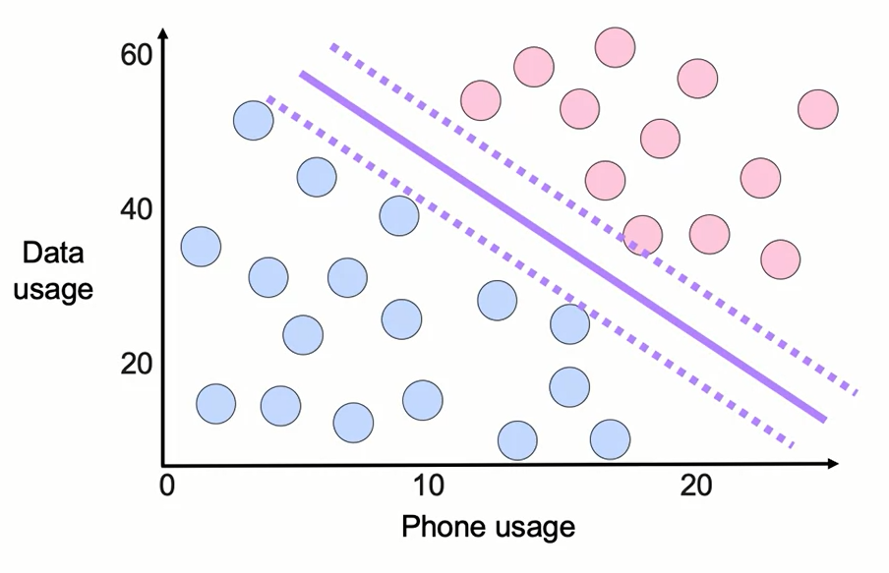
Classification with SVMs
What we've learned so far is this linear version of support vector machines. This is the support vector machine in its simplest form
In addition to performing linear classification, SVMs can efficiently perform a non-linear classification using what is called the kernel trick, implicitly mapping their inputs into high-dimensional feature spaces.

Slide 4
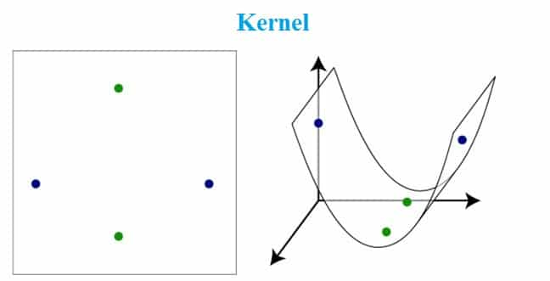
The Kernel
Kernel: A kernel is a method of placing a two dimensional plane into a higher dimensional space, so that it is curved in the higher dimensional space. (In simple terms, a kernel is a function from the low dimensional space into a higher dimensional space.)
The kernel machine are slow to compute for datasets larger than a couple of thousand examples without parallel processing.

Slide 5
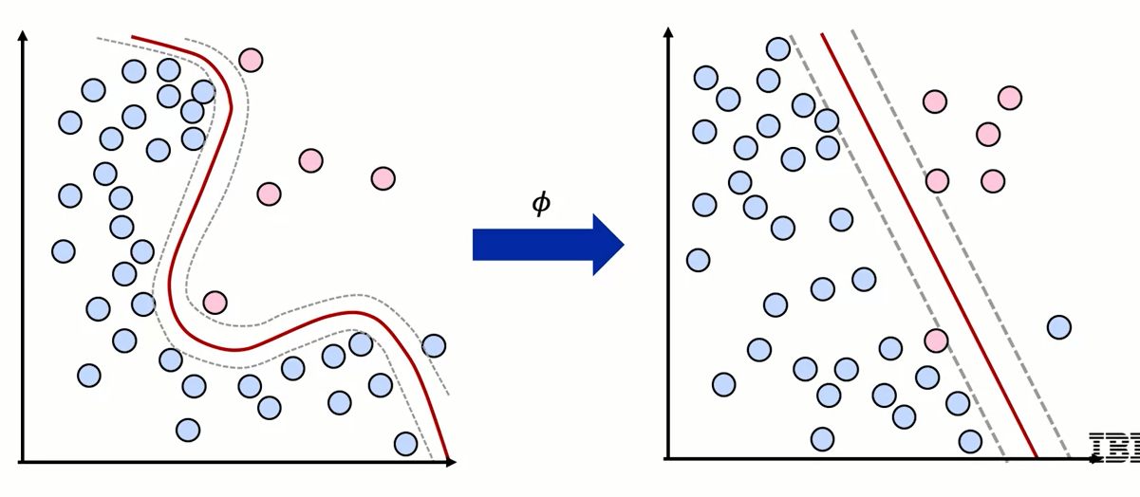
Non-Linear Decision Boundaries with SVM
Non-linear data can be made linear with higher dimensionality

Slide 6
The Kernel Trick
Simply computing the dot product between the images of all pairs of data in the feature space instead of computing the coordinates of the data in that space.
Methods based on this technique, i.e. instead of directly calculating the coordinates of a point in the new space, we compute the dot product between two points in the new space, collectively known as the kernel method.

Slide 7
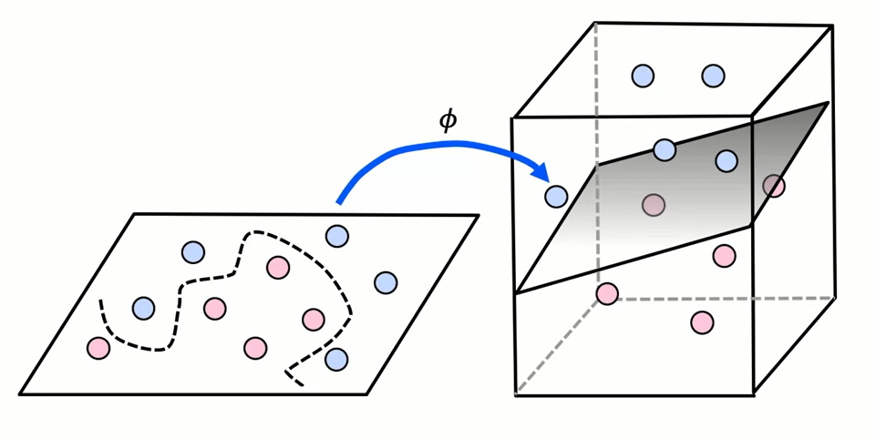
The Kernel Trick
Transform data so it is linearly separable

Slide 8

Common Kernel Functions in SVM
γ: gamma
Linear:
Radial Basis Function (RBF):

Slide 9


Common Kernel Functions in SVM
Sigmoid: this function is equivalent to a two-layer, perceptron model of the neural network, which is used as an activation function for artificial neurons.
Polynomial: It represents the similarity of vectors in the training set of data in a feature space over polynomials of the original variables used in the kernel.
where d is the degree of the polynomial and
r ≥ 0 is a free parameter trading off the influence of higher-order versus lower-order terms in the polynomial.

Slide 10
SVM Kernel
Pros of Kernelized SVM:
They perform very well on a range of datasets.
They are versatile: different kernel functions can be specified, or custom kernels can also be defined for specific datatypes.
They work well for both high and low dimensional data.
Cons of Kernelized SVM:
Efficiency (running time and memory usage) decreases as the size of the training set increases.
Needs careful normalization of input data and parameter tuning.
Does not provide a direct probability estimator.
Difficult to interpret why a prediction was made.

Slide 11
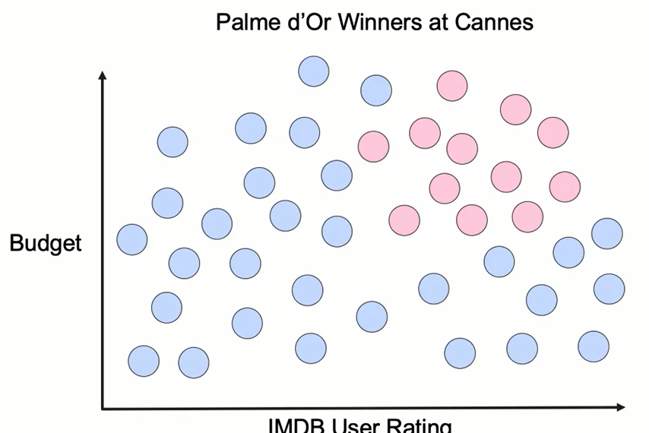
SVM Gaussian Kernel

Slide 12
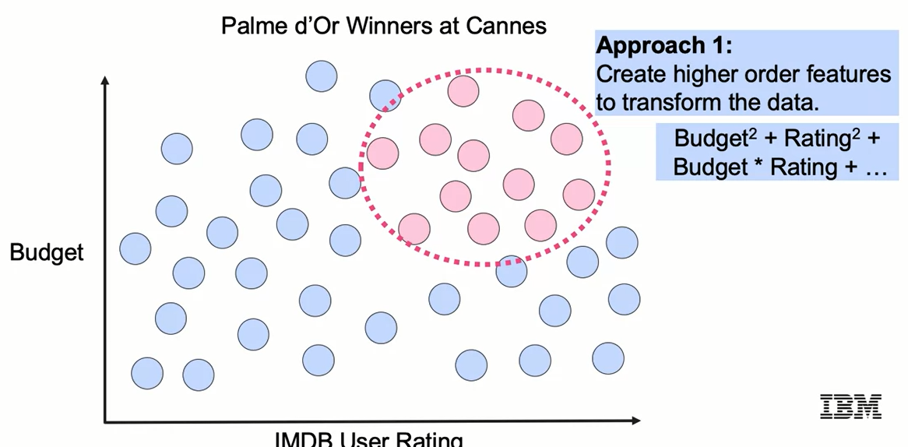
SVM Gaussian Kernel

Slide 13
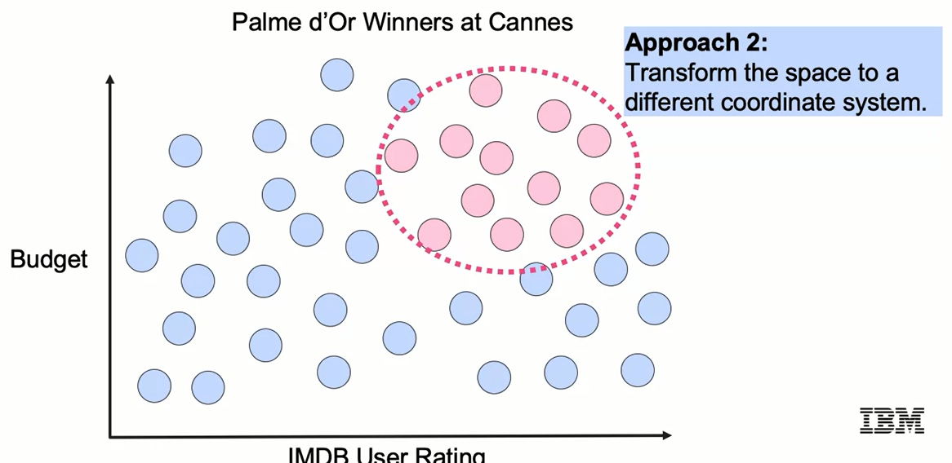
SVM Gaussian Kernel

Slide 14
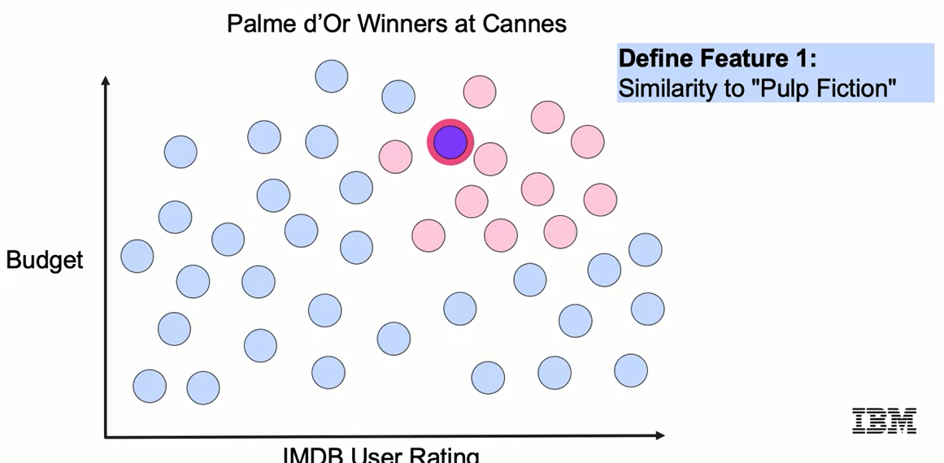
SVM Gaussian Kernel

Slide 15
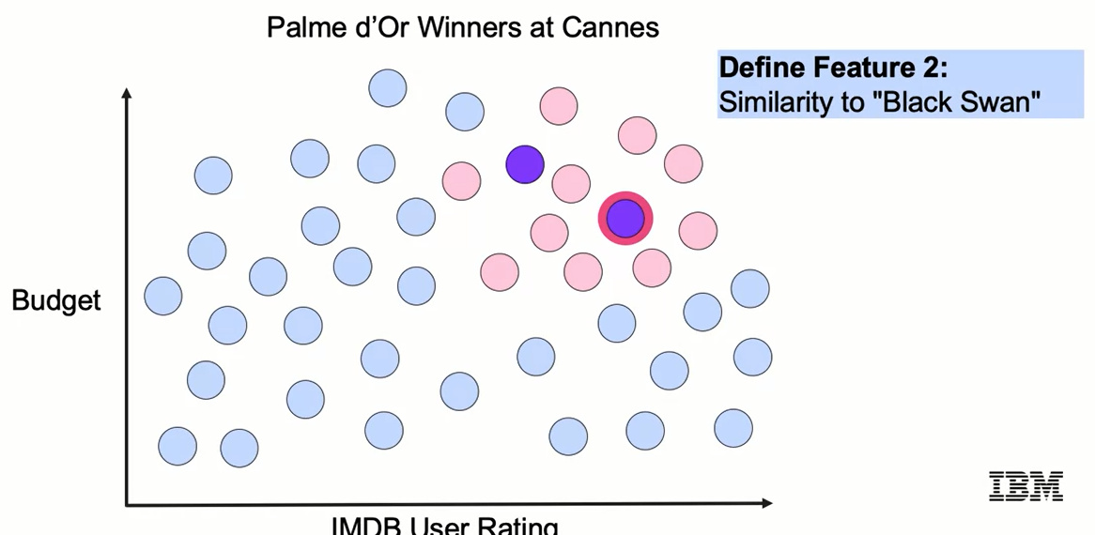
SVM Gaussian Kernel

Slide 16
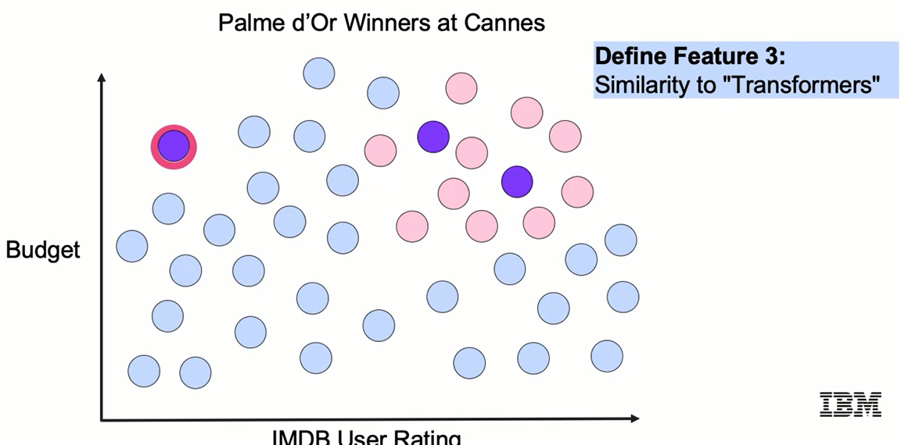
SVM Gaussian Kernel

Slide 17
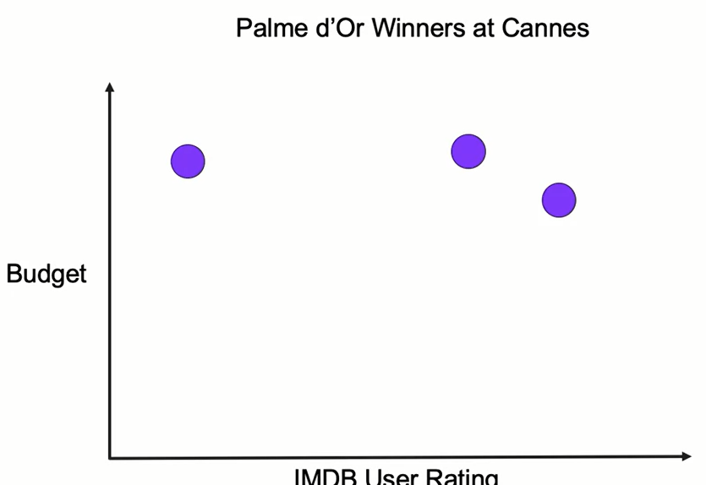
SVM Gaussian Kernel

Slide 18
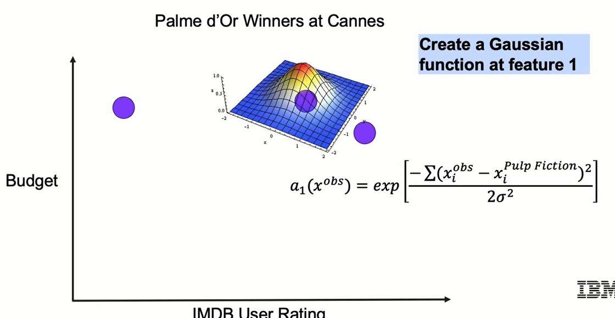
SVM Gaussian Kernel

Slide 19
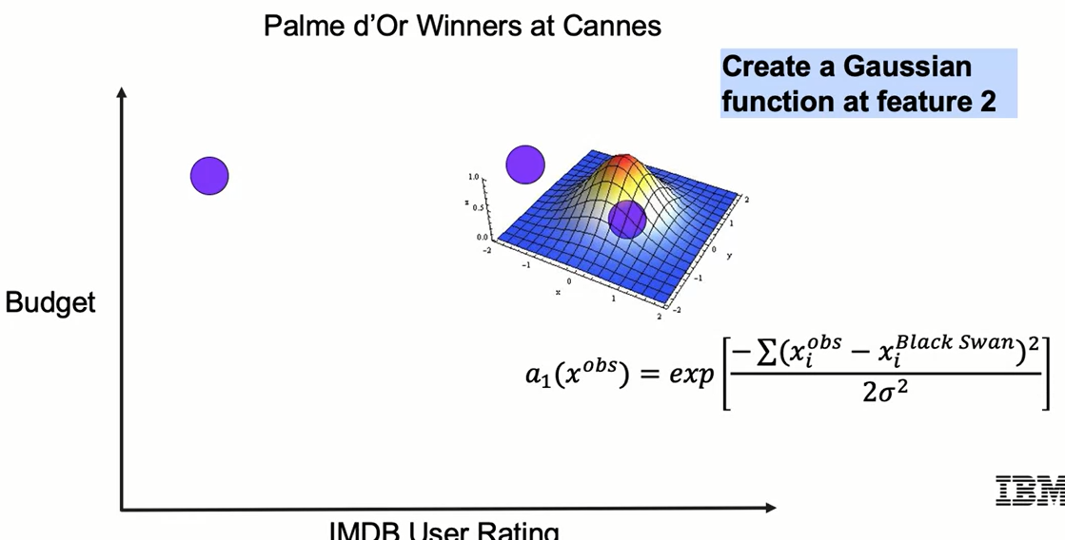
SVM Gaussian Kernel

Slide 20
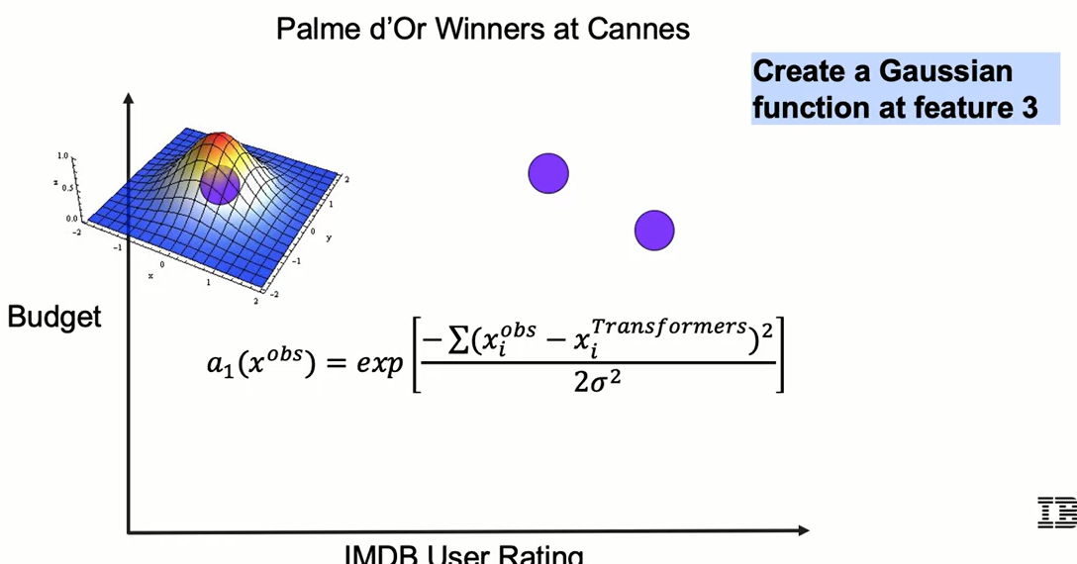
SVM Gaussian Kernel

Slide 21
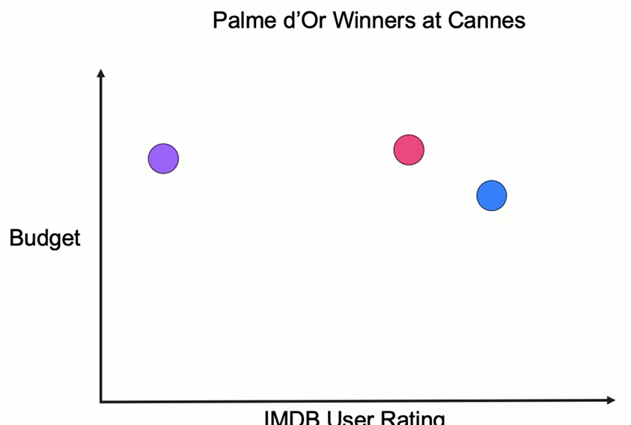
SVM Gaussian Kernel

Slide 22
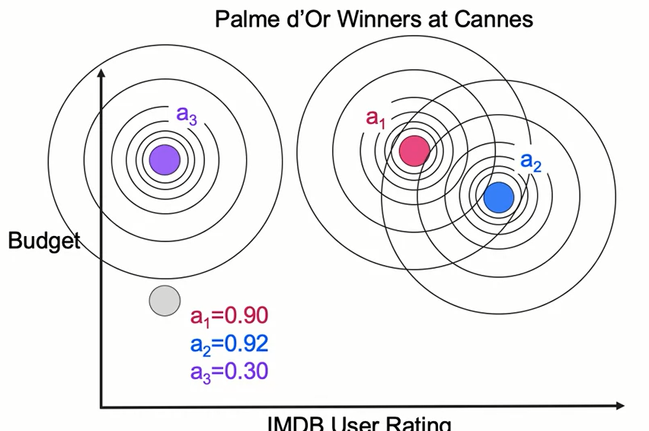
SVM Gaussian Kernel

Slide 23
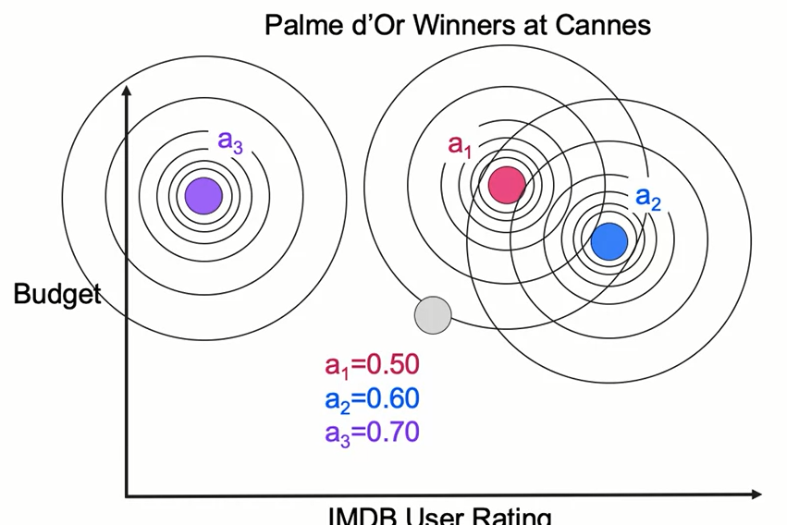
SVM Gaussian Kernel

Slide 24
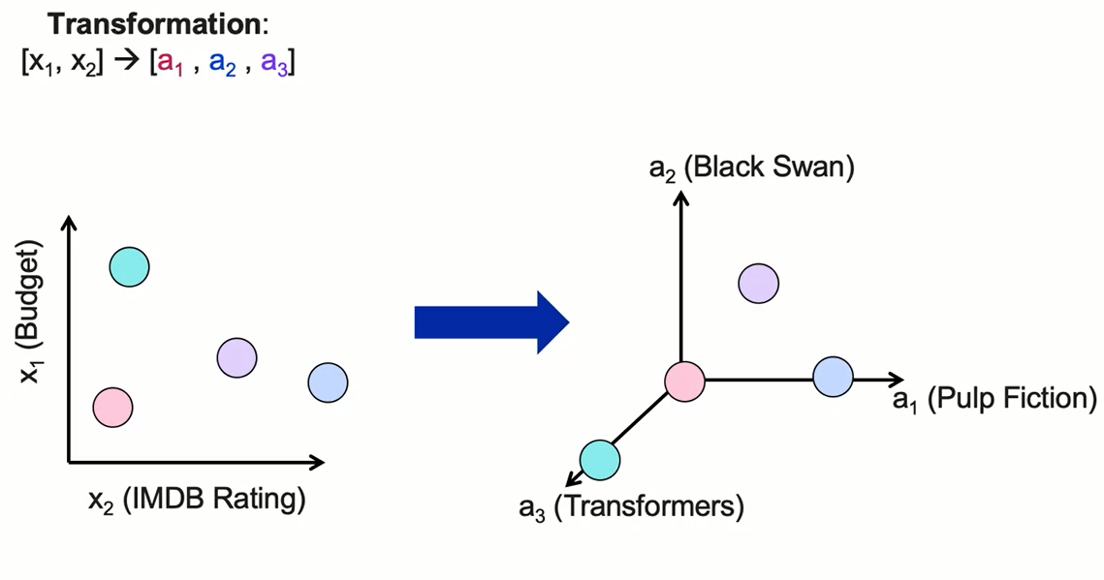
SVM Gaussian Kernel

Slide 25
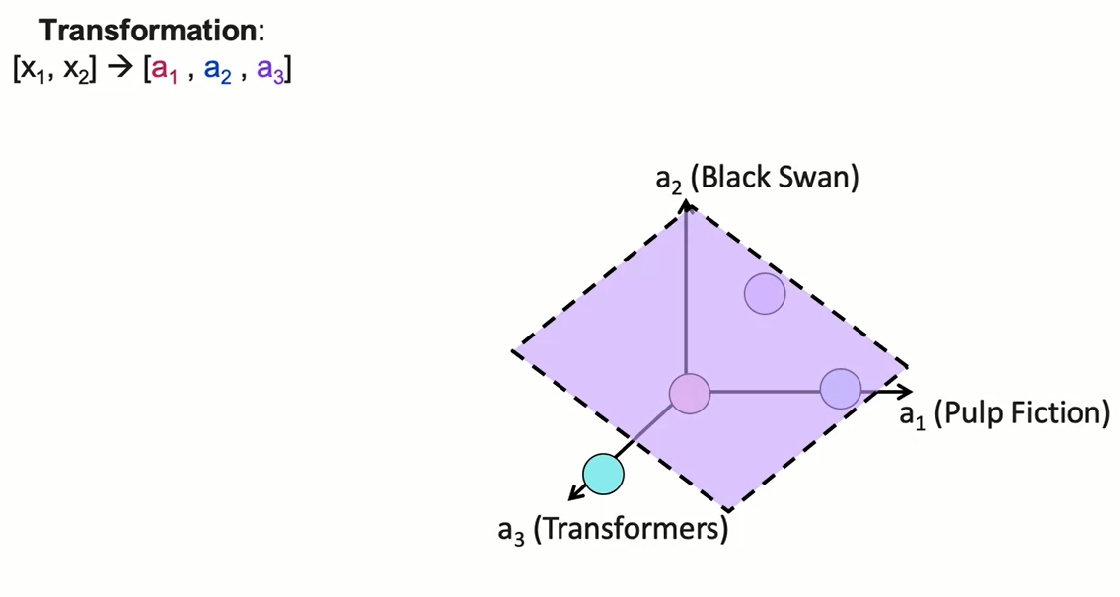
Classification in the New Space

Slide 26
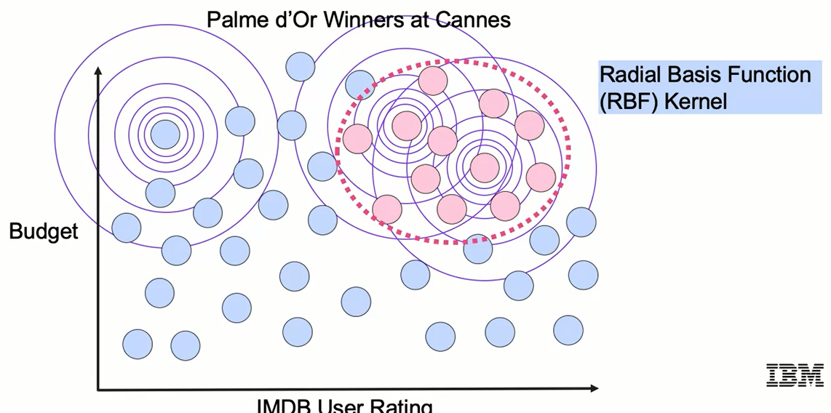
SVM Gaussian Kernel

Slide 27
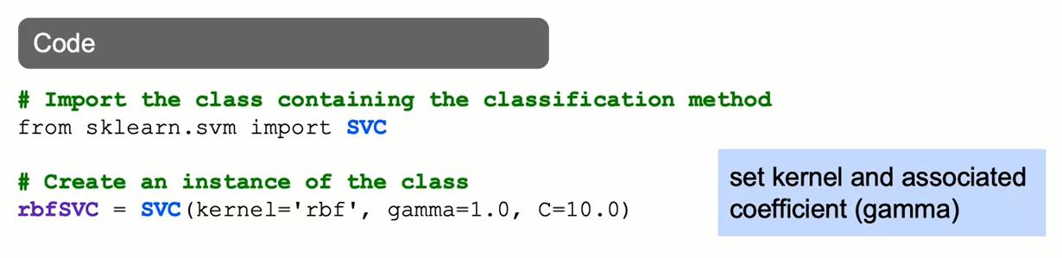
SVMs with Kernels: The Syntax

Slide 28
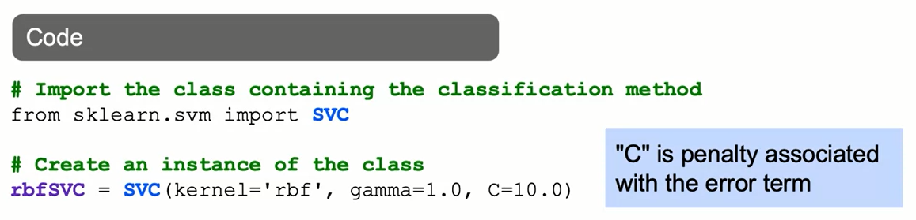
SVMs with Kernels: The Syntax

Slide 29
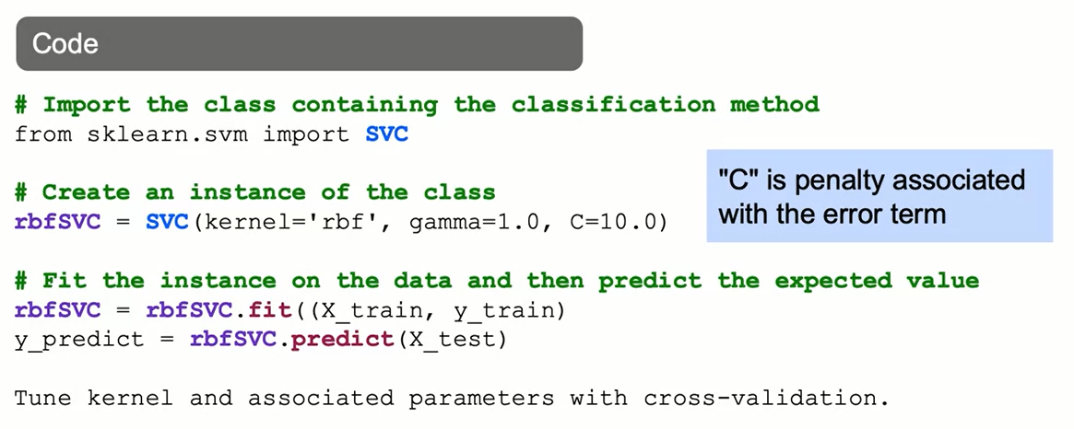
SVMs with Kernels: The Syntax

Slide 30
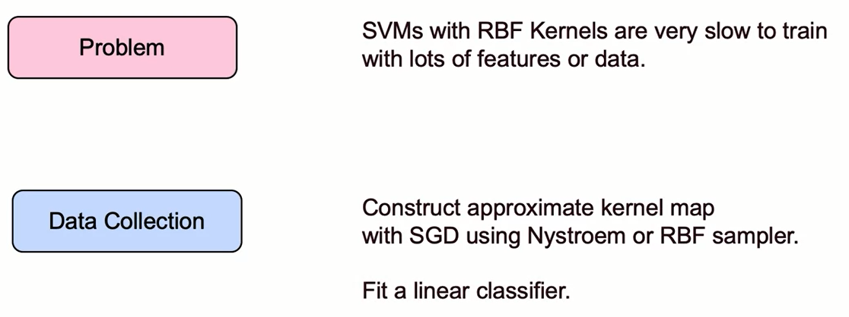
Machine Learning Workflow

Slide 31
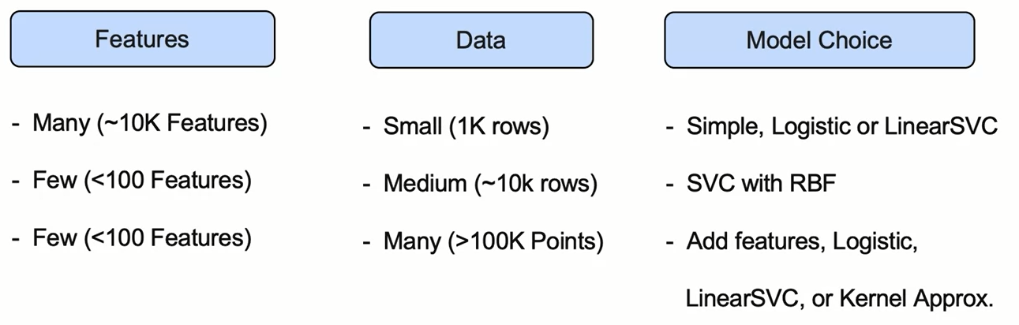
Machine Learning Workflow

Slide 32
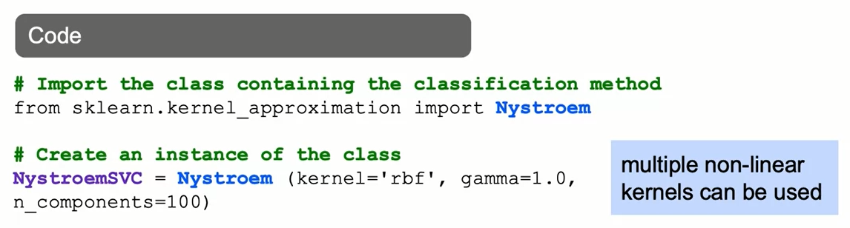
Faster Kernel Transformations: The Syntax

Slide 33

Faster Kernel Transformations: The Syntax

Slide 34
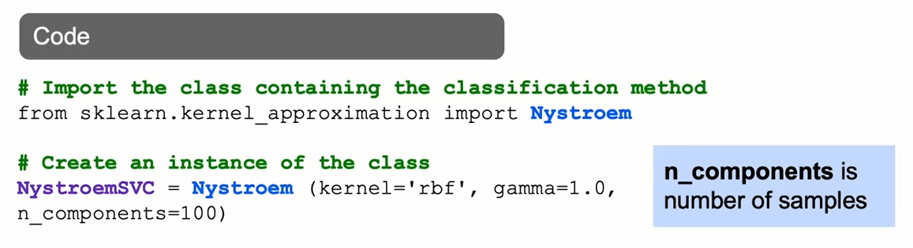
Faster Kernel Transformations: The Syntax

Slide 35
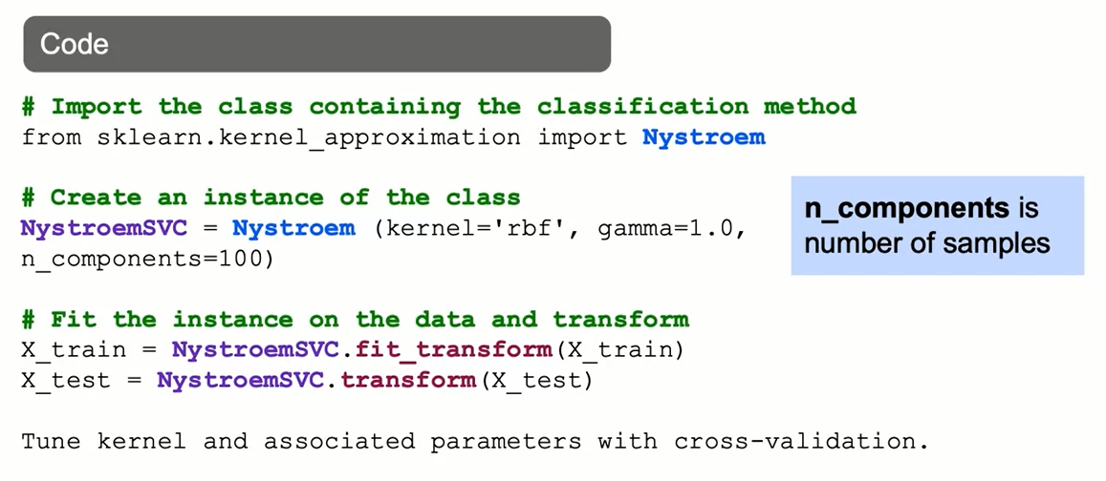
Faster Kernel Transformations: The Syntax

Slide 36
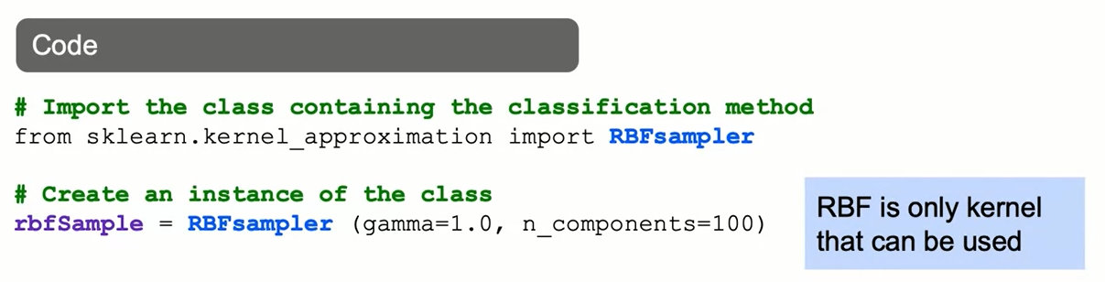
Faster Kernel Transformations: The Syntax

Slide 37

Faster Kernel Transformations: The Syntax

Slide 38
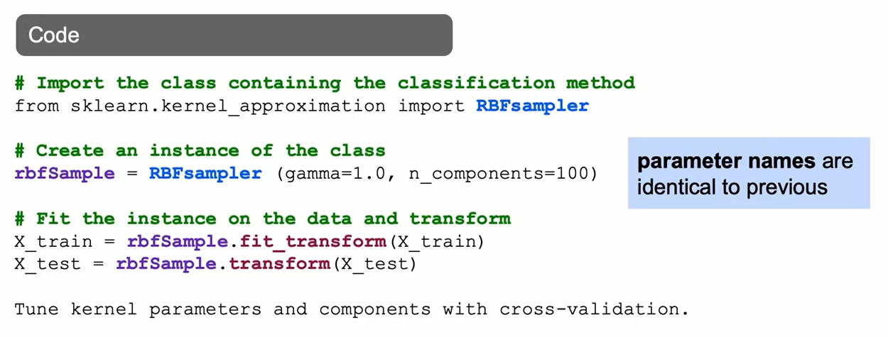
Faster Kernel Transformations: The Syntax

Slide 39
Summary
By using gaussian kernels, you transform your data space vectors into a different coordinate system, and may have better chances of finding a hyperplane that classifies well your data.SVMs with RBFs Kernels are slow to train with data sets that are large or have many features.

Slide 40
Learning Recap
In this section, we learned that:
- Using kernels with Support Vector Machines (SVM)
- Non-linear decision boundaries
- Implementation of SVM kernel modeling

